Slide 1
VR MALL
Investment Pitch Deck

Slide 2
Solutions On Problem
For Consumers:
3D Product Visualization
AI-Powered Recommendations
Social Shopping
Cross-Platform Access
For Retailers:
Virtual Storefronts
Analytics Dashboard
Global Reach

Slide 3

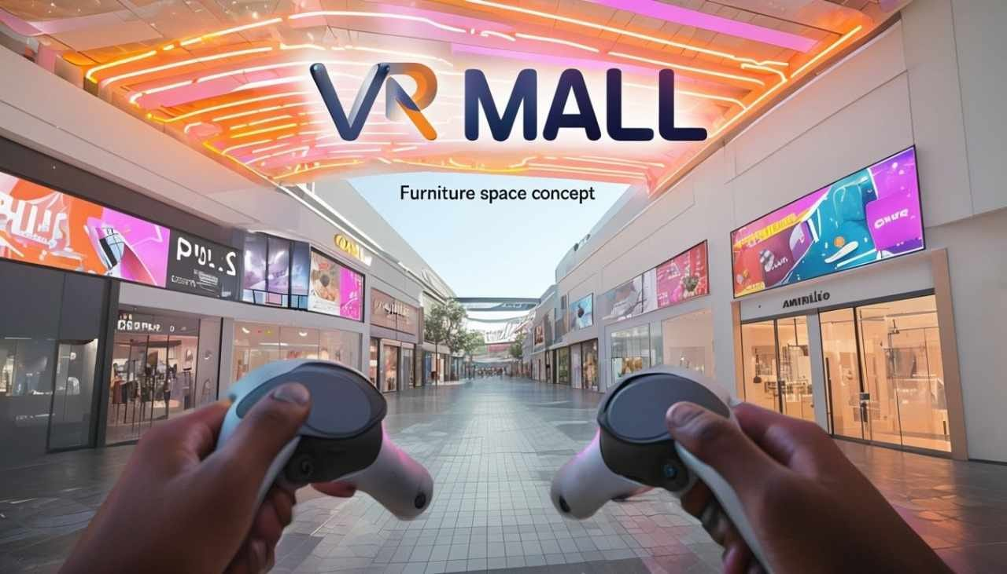
How It Works

Slide 4
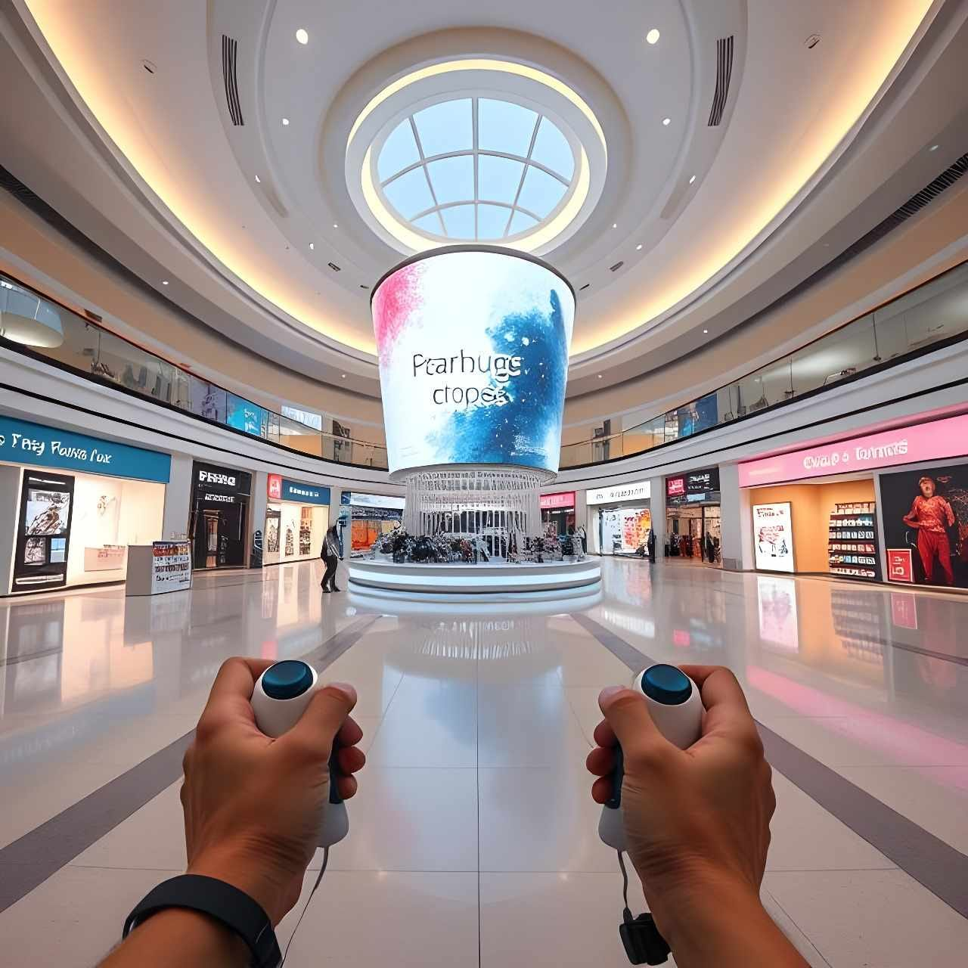
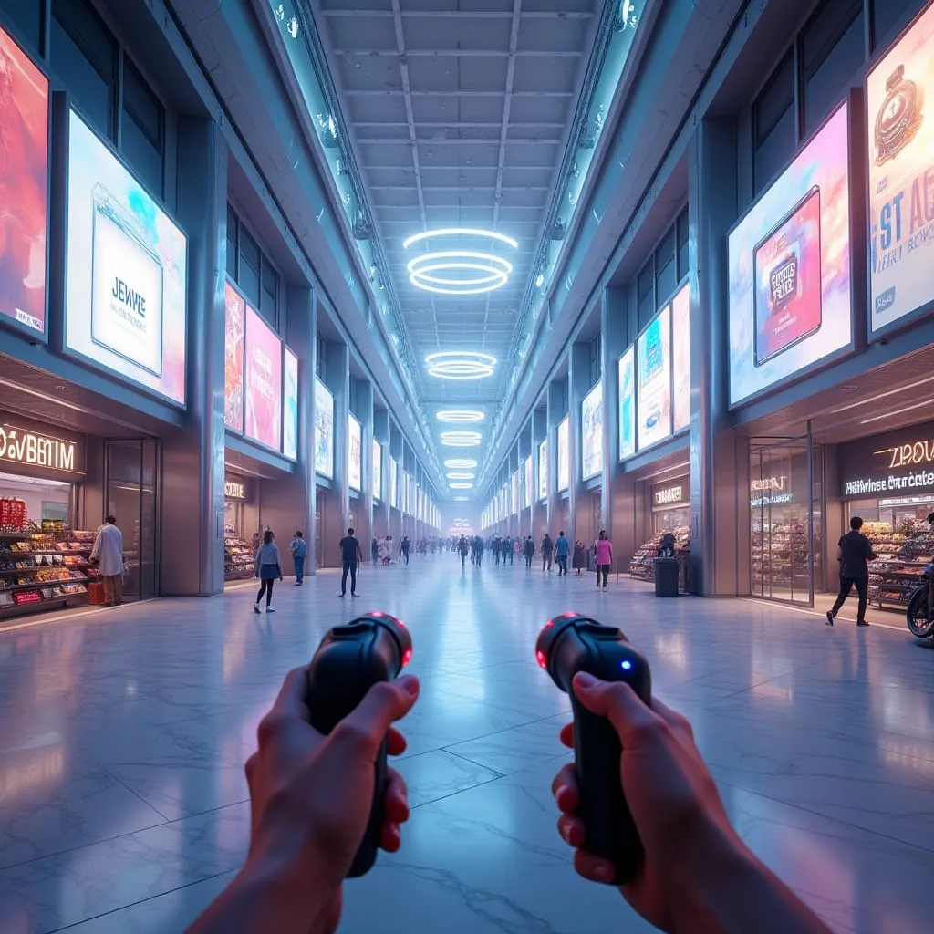
How It Works

Slide 5
Business Model
Subscription
Monthly Subscription Price 150 $
Advertising
Price of Video Advertising Per Minute 10 $
Price of Banner Advertising Per Day 2,000 $
3D Modelling
Average Price Of 3D Modelling Of Goods Per Companies 30 $
FARMER ACQUISITION

Slide 6



Team
Irakli Kerkadze
CO - CEO
Rati Kerkadze
CO - CEO
Bachana Kuchava
CO - CEO

Slide 7

Go to Market Strategy

Slide 8

Go to Market Strategy
2025 Georgia
2026 Azerbaijan, Armenia
2027 Turkey, Uzbekistan, Tajikistan, Kyrgyzstan, Kazakhstan
2028 Moldova, Belarus, Bulgaria

Slide 9
Market Analysis
TAM
4.25 M
Total Number Of Active E-Commerce Companies – Target Countries.
SAM
191 K
Total Number Of House Developments, electro tech, acessories, remonts related companies– Target Countries.
SOM
15 K
Number Of Companies acquired in Target Countries Next 5 Year
4.25 M
191 K
15 K

Slide 10




Competitors

Slide 11
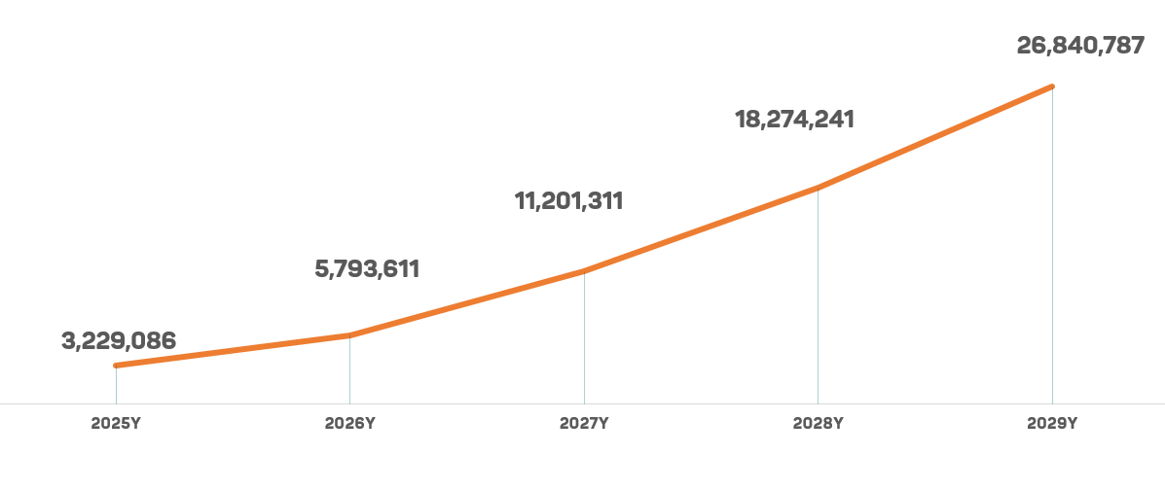
Revenue Projections

Slide 12




Valuation
Valuation Methods
Post Money Valuation
Weights %
Weighted Post Money Valuation
Comparable Analysis Method | 2,100,000 | 15,0% | 315,000
Berkus Method | 1,300,000 | 15,0% | 195,000
ScoreCard Method | 2,117,063 | 15,0% | 317,559
Risk Factor Summation Method | 2,600,000 | 15,0% | 390,000
DCF Multiple Method | 11,127,157 | 12,0% | 1,335,259
DCF Perpetual Growth Method | 7,524,090 | 12,0% | 902,891
Venture Capital Method | 5,314,443 | 16,0% | 850,311
$
VR MALL’s
Valuation:
4,306,020 $
OUR INVESTMENT ADVISOR WWW.INV ESTO.GE

Slide 13


Investment Offer
Equity Stake 11 .0 %
Investment Returns
Funds requested $ 466 K
IRR 87 .7 %
ROI 23 .3 X
VR MALL’s Valuation
4,306,020 $

